Slide 1
Web Techniques
REST services
Web user interfaces

Slide 2
Section 1: REST Services
Overview
Demo applications
Server application
Client application

Slide 3
Overview
In this section we'll see how to:
Implement a REST service that returns DataFrame data
Implement a client that calls a REST service and consumes the data
The REST service app requires the following libraries:
The client app requires the following library:
pip install flask
pip install flask_restful
pip install waitress
pip install requests

Slide 4
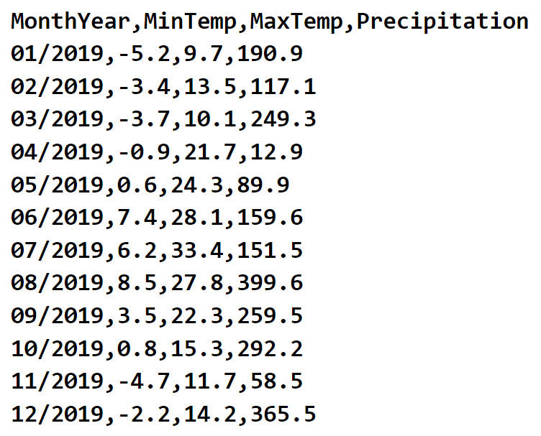
Demo Applications
In the Rest folder, we've implemented 2 demo apps:
server.py
client.py
The applications are based on the following time series data:
BergenWeather2019.csv

Slide 5
Server Application (1 of 4)
Here's the overall structure of the server application:
Run the application as follows:
from flask import Flask
from flask_restful import Api
from waitress import serve
import pandas as pd
import json
app = Flask(__name__)
api = Api(app)
df = pd.read_csv('BergenWeather2019.csv',
parse_dates=['MonthYear'],
index_col='MonthYear',
date_format='%m/%Y')
# REST service endpoints - see the following slides…
serve(app, host="0.0.0.0", port=8080)
server.py
python server.py

Slide 6
Server Application (2 of 4)
This endpoint returns all the data in the DataFrame:
Try the following URL in a browser:
http://localhost:8080/api/weather
@app.route('/api/weather', methods=['GET'])
def get_all_data():
return Response(df.to_json(orient='index'), … … … )
server.py
For more info about how to write a DataFrame to JSON, see: https://pandas.pydata.org/pandas-docs/stable/reference/api/pandas.Series.to_json.html

Slide 7
Server Application (3 of 4)
This endpoint returns a row with a specified month and year:
Try the following URLs in a browser:
http://localhost:8080/api/weather/01-2019
http://localhost:8080/api/weather/wibble
@app.route('/api/weather/<month_year>', methods=['GET'])
def get_data_for_month_year(month_year):
if month_year in df.index:
return Response(df.loc[month_year].to_json(orient='index'), … … … )
else:
return f'Invalid month_year index "{month_year}"', 404
server.py

Slide 8
Server Application (4 of 4)
These endpoints returns specific pieces of data:
Try out these endpoints in a browser
@app.route('/api/weather/annual-min-temp', methods=['GET'])
def get_annual_min_temp():
annual_min_temp = pd.Series.min(df.MinTemp)
return json.dumps(annual_min_temp), 200
@app.route('/api/weather/annual-max-temp', methods=['GET'])
def get_annual_max_temp():
annual_max_temp = pd.Series.max(df.MaxTemp)
return json.dumps(annual_max_temp), 200
@app.route('/api/weather/annual-total-precipitation', methods=['GET'])
def annual_total_precipitation():
annual_total_precipitation = pd.Series.sum(df.Precipitation)
return json.dumps(annual_total_precipitation), 200
server.py

Slide 9
Client Application (1 of 4)
Here's the overall structure of the client application:
Run the application as follows:
import requests
import pandas as pd
base_address = 'http://localhost:8080/api/weather'
# Call REST service APIs - see following slides…
client.py
python client.py

Slide 10
Client Application (2 of 4)
This code calls the REST endpoint to get all weather data:
Note the following points:
response.text reads the HTTP response body into a string
pd.read_json() parses the string as JSON, and from this JSON it creates a DataFrame object
def demo_get_all_data():
response = requests.get(base_address)
if response.status_code != 200:
print("Oops, couldn't get data")
else:
df = pd.read_json(StringIO(response.text), orient='index')
print('All data\n', df)
client.py

Slide 11
Client Application (3 of 4)
This code calls the REST endpoint that gets one row:
def demo_get_data_for_month_year(month_year):
response = requests.get(f'{base_address}/{month_year}')
if response.status_code != 200:
print("\nOops, couldn't get data")
else:
df = pd.read_json(StringIO(response.text), orient='index')
print(f'\nData for month_year {month_year}\n', df)
client.py

Slide 12
Client Application (4 of 4)
This code calls the endpoint to get the annual min temperature:
Also see the following functions, which are similar:
demo_get_annual_max_temp()
demo_get_annual_total_precipitation()
def demo_get_annual_min_temp():
response = requests.get(f'{base_address}/annual-min-temp')
if response.status_code != 200:
print("\nOops, couldn't get data")
else:
min = response.json()
print(f'\nAnnual minimum temperature: {min}C')
client.py

Slide 13
Section 2: Web User Interfaces
Overview
Demo applications
Server application
Client application

Slide 14
Overview
In this section we'll see how to:
Implement a web server app that returns a web page displaying data from a DataFrame, as an HTML <table>
Implement a web client app that scrapes the web page to create a DataFrame from the HTML <table>
The web server app uses regular Python classes and functions
The web client app requires the following libraries:
pip install requests
pip install bs4

Slide 15
Demo Applications
In the Html folder, we've implemented 2 demo apps:
server.py
client.py
The applications are based on the same data as before:
BergenWeather2019.csv

Slide 16
Server Application (1 of 2)
The server application performs the following tasks:
Reads the weather data into a DataFrame
Writes the DataFrame to HTML (as a <table> element)
Injects the HTML <table> into a template HTML file (index.html)
Returns the HTML content to the client
Run the application as follows:
python server.py

Slide 17
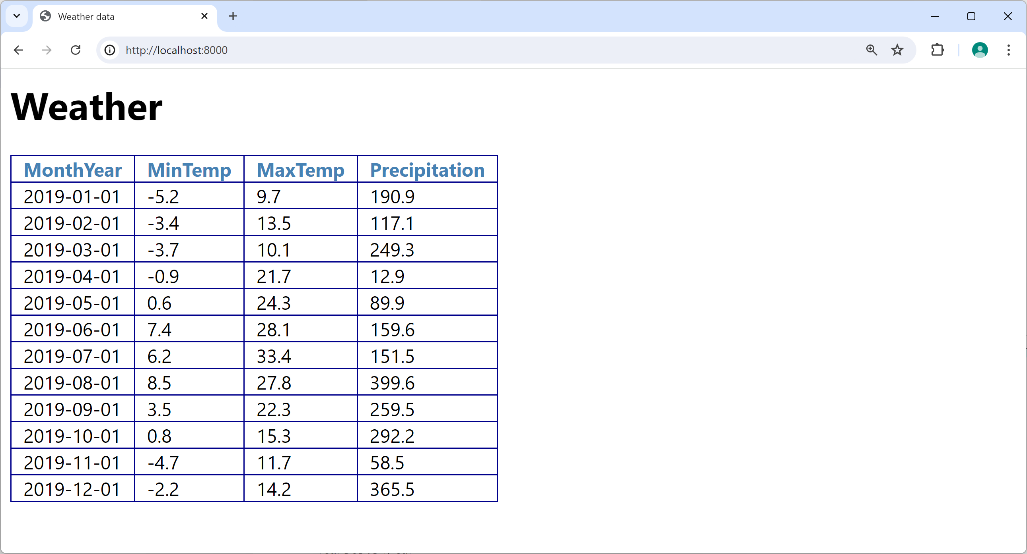
Server Application (2 of 2)
Open a browser and go to http://localhost:8000/

Slide 18
Client Application (1 of 2)
The client application performs the following tasks:
Sends an HTTP request to http://localhost:8000/
Parses the HTML response using the Beautiful Soup library
Uses the Beautiful Soup library to locate the HTML <table>
Creates a DataFrame from the HTML <table>
Run the application as follows:
python client.py

Slide 19
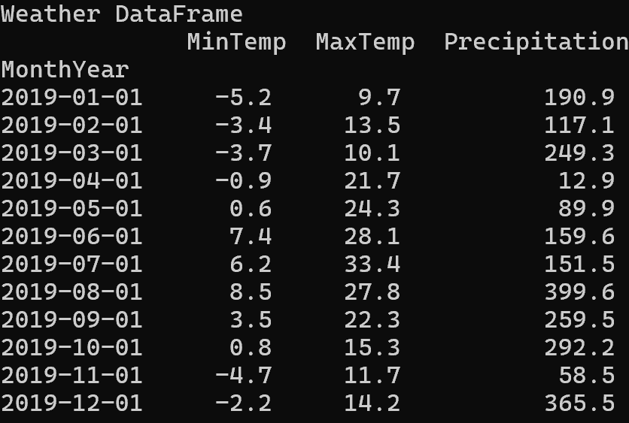
Client Application (2 of 2)
Here's the output from the client application:

Slide 20
Summary
REST services
Web user interfaces

